Slide 1


HOW WE INCREASED
PHONE CALLS 414%
& WEBSITE VISITS 351%
Local SEO Campaigns for Law Firms

Slide 2

In local SEO, we’re dealing with two algorithms,
the ORGANIC AND MAPS ALGORITHMS,
which can complicate optimization strategies.
Maps is tricky because it runs on multiple
data sets, which complicates how the algorithm defines a particular location.
The local algorithm is also constantly
changing, making the map pack a
moving target.
The extreme competitiveness of legal
services is easy to understand once you see
the generated in revenue – it’s projected to be
OVER $348 billion in 2024 with only a small
number of searches, according to this report
compiled by STATISTA

Slide 3

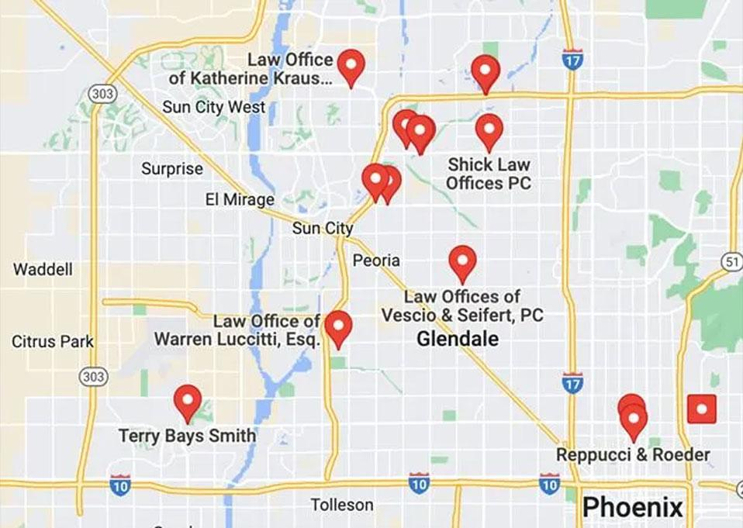
The challenge with this campaign was the
listing did NOT RANK in the top 20 for most target keywords. There was densely populated law firms in the area, which you can see in the screenshot to the left, and the listing was weak compared to these competitors.
Law firms also deal with MORE FREQUENT FILTERING ISSUES, because it’s common for many law firms to be in the same building. Google will ONLY SHOW ONE listing per address for each niche. The suite number is not taken into account, so different suite numbers at the same address will not show more than one.

Slide 4


RECAP OF THE RESULTS
414% increase in phone calls
351% increase in website visits
198% increase in indirect queries
384% increase in views on maps 6.2k
274% increase in views on search (5.1k)
92% increase in driving directions

Slide 5

CAMPAIGN
CHALLENGES
When the client initially
approached us, he had no map
visibility for the keywords they wanted
to target. So we ran a Local SEO Audit
and looked into the potential issues
the client could face. We also did a
thorough analysis of the niche and
competition within the targeted
location, which is how we found the
densely populated area.

Slide 6

PROBLEMS WE ENCOUNTERED :
Brand name inconsistencies
Other lawyers showing for the same address.
The address is at a shared office space
Possum filter in the same building

Slide 7

To complete all this work,
we decided on an aggressive
plan MONTHLY GBP SEO campaign in order to tackle as
many areas as possible.
Our success proved this higher
campaign level to be the right
Approach - you get what you pay for in SEO…
We completed the NAP, GMB,
and Location Page Audit in the
first month and added the
campaign to our trackers.

Slide 8

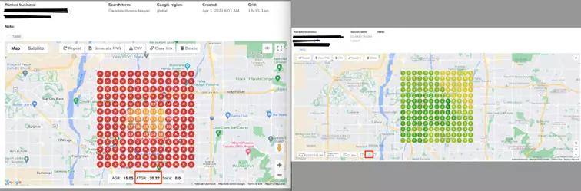
GeoGrids previously showing very minimal visibility, had now secured map pack positions in the majority of the grids. This was after completing only 5 months of our highest Monthly GBP Campaign.
We compare the baseline & update GeoGrids below for 5 different keywords. We have blurred out some of the information to protect the client’s identity.

Slide 9

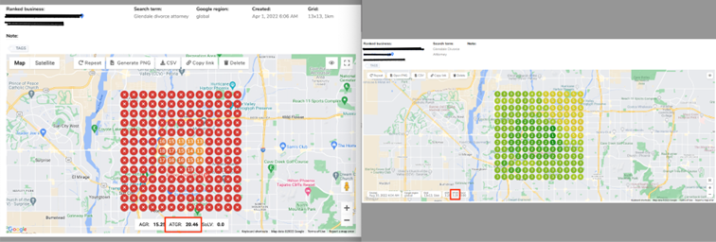
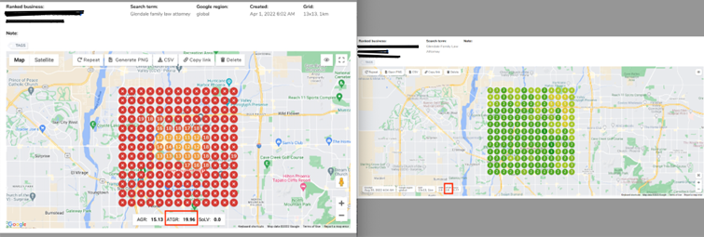
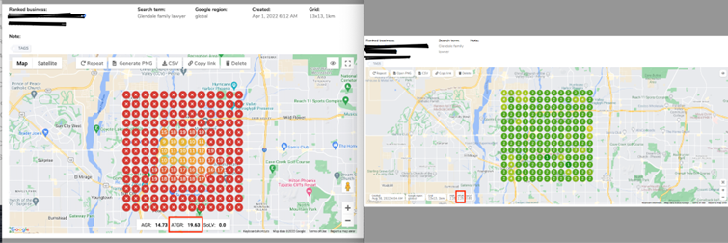
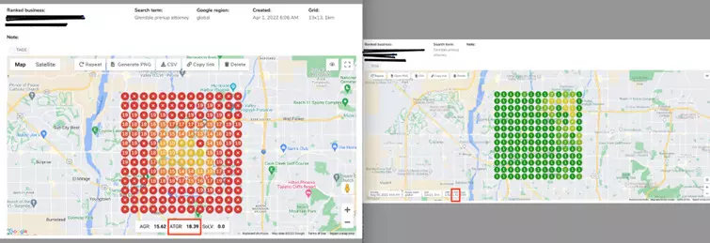
Because of the improved visibility shown in above grids, we saw significant IMPROVEMENT IN ALL ENGAGEMENT TYPES from the baseline.
This brought in an influx of leads and clients for their business

Slide 10

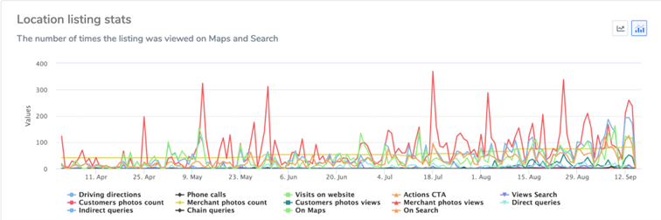
WHAT’S NEXT FOR THE CAMPAIGN?
Moving forward, we will work on targeting broad-term keywords, adding other keywords
to the mix to expand visibility, increasing the radius coverage, monitoring the results, and
then start targeting a new set of highly-competitive keywords and updating the results.

Slide 11

WANT RESULT LIKE THIS?
To get a clear guide on what campaign
type is right for your client, please check out our Free Campaign Recommendations or reach out to us directly at
{your email}. We can review
your business’s specific situation and make
personalized recommendations based on
what we find. This ensures you are using
the proper campaigns and achieve
maximum results.

