Slide 1

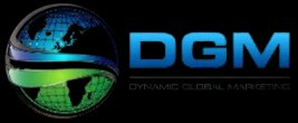
HOW WE GOT AN ADDITIONAL CALL
EVERY DAY FOR AN
INSURANCE COMPANY

Slide 2

If you’re looking to increase phone calls, website visits, and overall online visibility,
read how one insurance company combined our LOCAL SEO CAMPAIGN and ORGANIC SEO CAMPAIGN to do just that. This case study will show you the results you can achieve when you combine our local and organic SEO packages.

Slide 3

During this campaign we
RANKED #1 FOR
THEIR TOP KEYWORD
with our combined SEO efforts. Furthermore, we maintained the #1 position rankings for MORE THAN FOUR MONTHS.
Our client ranked at the top of local searches for insurance companies, enabling them to beat the competition and gain more business.

Slide 4


RECAP OF THE RESULTS
WE ACHIEVED
300+ MORE PHONE CALLS
RANKED #1 ORGANICALLY
(Additional 1+ Phone Call Per Day)
for High Volume Terms, Including "Insurance",
"City+ Insurance", and "Insurance Company"
RANKED #1 LOCALLY FOR
TOP KEYWORDS
EXPAND KEYWORD RANKINGS
to Additional High Value Search Terms
Including "Car Insurance Near Me"
& "Insurance Near Me"
26% INCREASE
MAINTAINED #1 POSITIONS
in Form Submissions
Throughout Campaign

Slide 5

OUR LOCAL SEO
STRATEGY
A strong local foundation is crucial for any business looking to dominate the 3 pack,
especially in high competition niches.
For our insurance client, this meant more brand signals, geo-relevant content, location pages, and authority stacking. While the listing was performing well already, our local optimization brought in more than one extra call per day.
What could 30 additional calls per month
do for your client?

Slide 6

LOCAL AND NICHE SIGNALS
BUILT INCLUDE:
Premium Local Press Release
PBN Map Embeds with NAP Mentions
Optimized Geo-Network
On-Page Local Optimization
Image Optimization
BRAND SIGNALS INCLUDED:
Data Aggregator Submissions
100+ Social Accounts to Build Brand
Once all these were built, we then boosted the signals for maximum power.

Slide 7

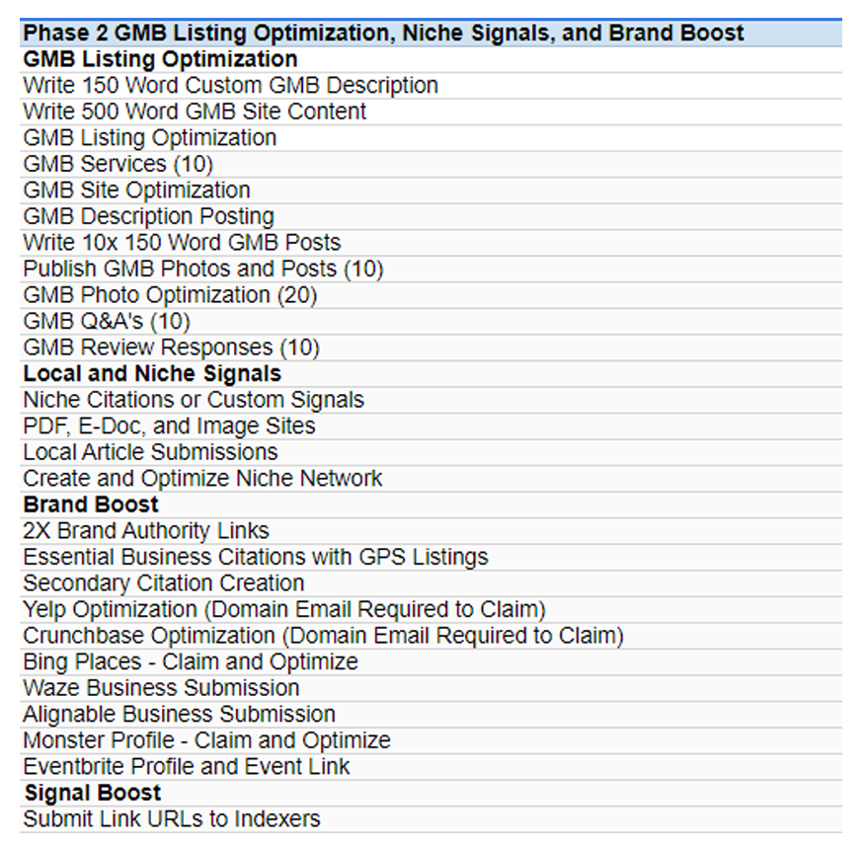
After we completed phase 1 of the campaign, we optimized the Google listing, created more niche-relevant signals, and boosted the brand.
In the screenshot to the right you can see all the work completed.
This ADVANCED BRAND SETUP process further pushed out the clients local rankings into more competitive markets.

Slide 8
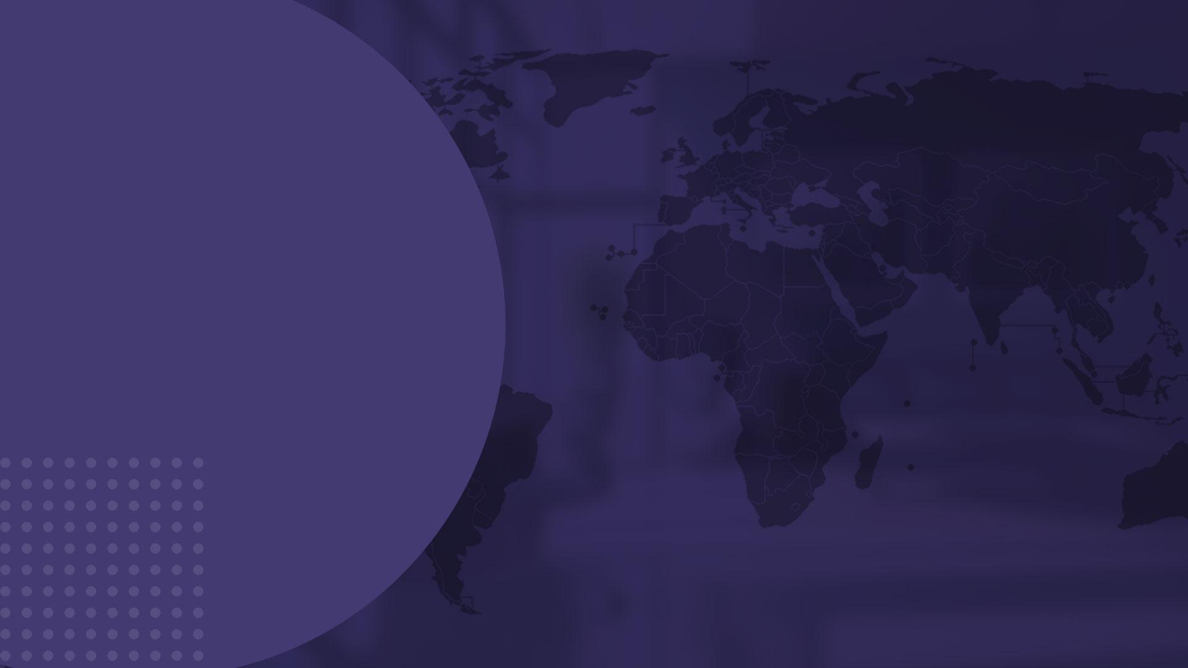
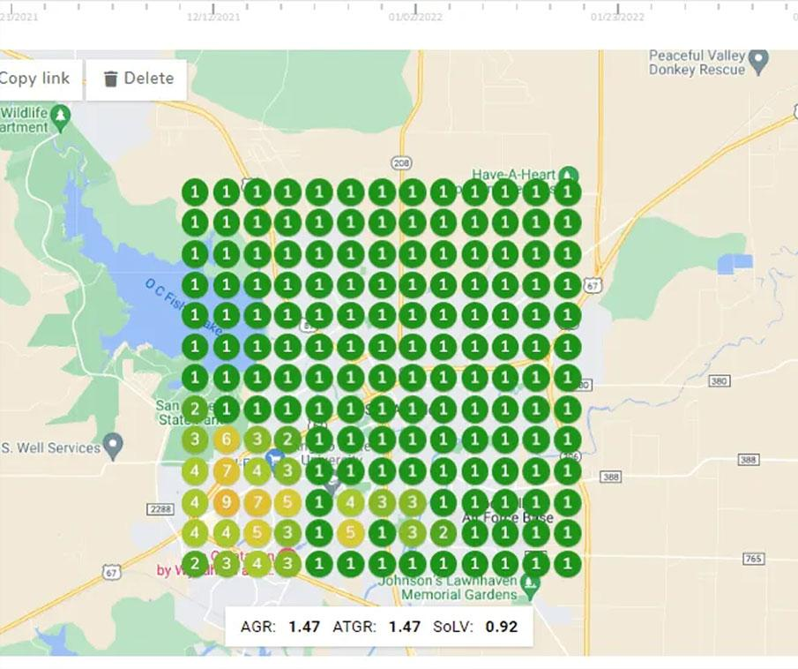
EXPANDED LOCAL
VISIBILITY WITH MORE
MAP PACK RANKINGS
We strengthened prominence and
relevance, with strong local optimization and niche relevant signal creation. This allowed us to overcome proximity and widen their local visibility to new areas. Local custom signals were an integral part of these map rankings.
The map pack domination was directly attributed to our consistent custom signal creation…

Slide 9

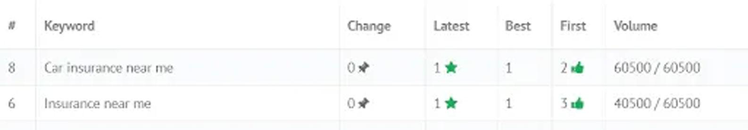
They were also ranking #1 locally for “car insurance near me” and “insurance near me”. These are high volume terms that brought in SIGNIFICANT ADDITIONAL LEADS.
Local signal creation DIRECTLY IMPACTS PROMINENCE of the listing – one of the top three ranking factors. You can see in the screenshot above the impact of stronger prominence on a listing’s performance.
These #1 map pack rankings for high search volume keywords lead to increases in lead flow, and thus revenue for the business.

Slide 10
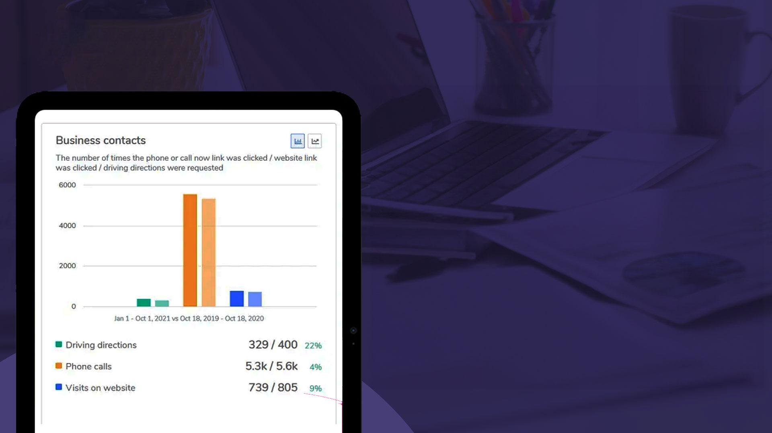
300+ ADDITIONAL CALLS
INCREASES IN WEBSITE
VISITS & DRIVING DIRECTIONS
Through the work described above in our Accelerated Setup and monthly local SEO campaigns, we secured more than 300 ADDITIONAL CALLS, which equated to more than one additional call every day. We also saw a 22% increase in driving direction requests with a slight 9% increase in site visits.
The 300 calls alone translated into a significant boost in lead flow and revenue.

Slide 11

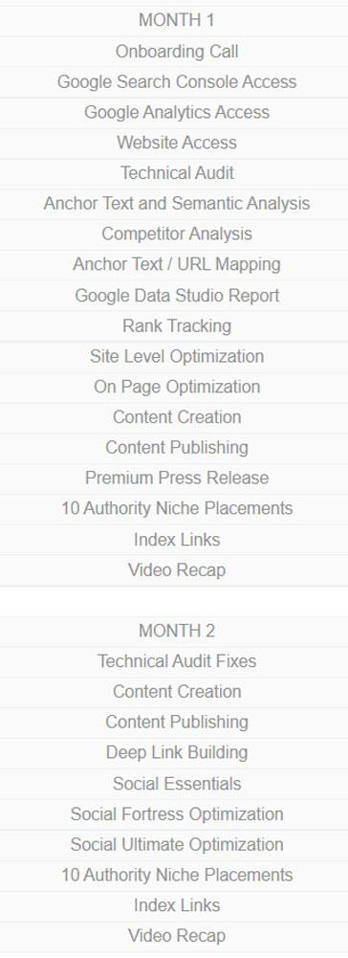
Competitor parity is at the center of our organic campaigns. We analyze top-ranking competitors for insights on the keywords, anchor texts, semantic phrases, etc. After we gather all the data, both site-level and page-level optimization begin. We pair this with content creation, authority press releases, high traffic guests posts, niche link placements, tiered link stacks, and link indexation to ensure Google bots will crawl the client’s site and add it to the search index.
OUR MANAGED SEO
STRATEGY
In addition to our standard Organic SEO process (to right), we optimized all website pages for Spanish insurance terms. We also created location pages for towns surrounding the business with significant population (+30% population). Our strategies increased the relevancy of our target phrases and provided more clarity for the buyer and their intent.

Slide 12

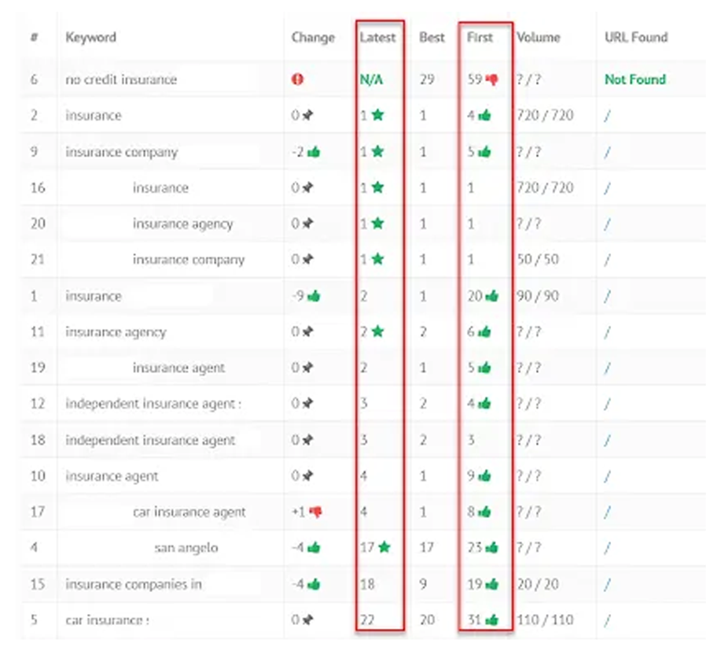
#1 ORGANIC RANKINGS
FOR HIGH VOLUME TERMS
Because of our location page creation, on-page optimization, link building and outreach strategies, this client achieved top organic rankings for many of their high value search terms.
We pushed major terms with high search volumes (some as high as 720 monthly searches) to the number one position. We achieved #1 position for 6 terms and top 3 position for 10 terms!

Slide 13


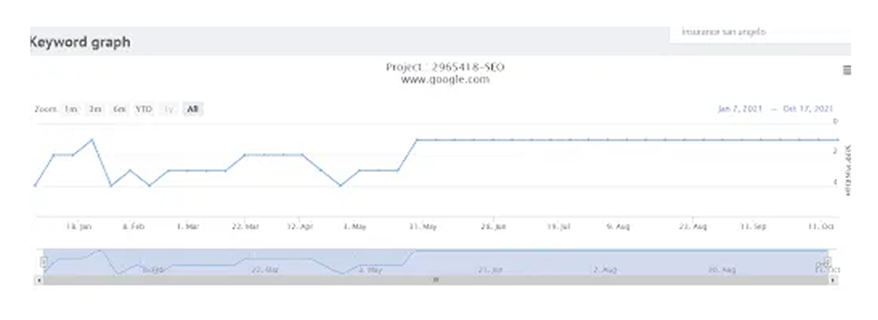
By leveraging brand building tasks we established long-term rankings for this client’s TOP INDUSTRY KEYWORDS. We maintained the
#1 rankings seen on the rank tracker below and on the previous slide for more than four months.

Slide 14


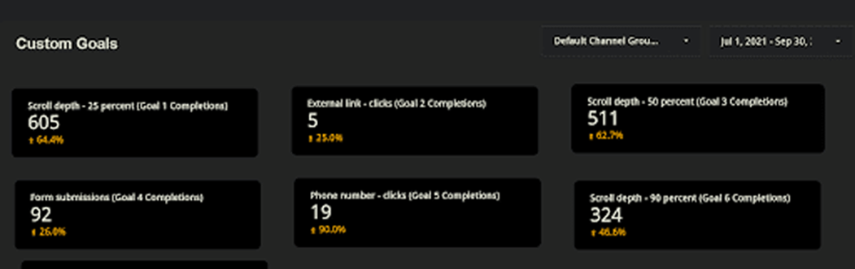
26% INCREASE IN FORM SUBMISSIONS
& 90% INCREASE IN CALLS
FROM THE WEBSITE
Because of top organic rankings and increased visibility, the client got 92 form submissions which equated to 26% growth in website leads. They also received 19 calls directly from the website, a 90% increase compared to before they’re campaign.

Slide 15

Our organic framework has proven to be very beneficial for our clients in the past and you can achieve similar results too!
Don’t hesitate to contact us if you are looking for experienced SEOs and top-notch services.

Slide 16

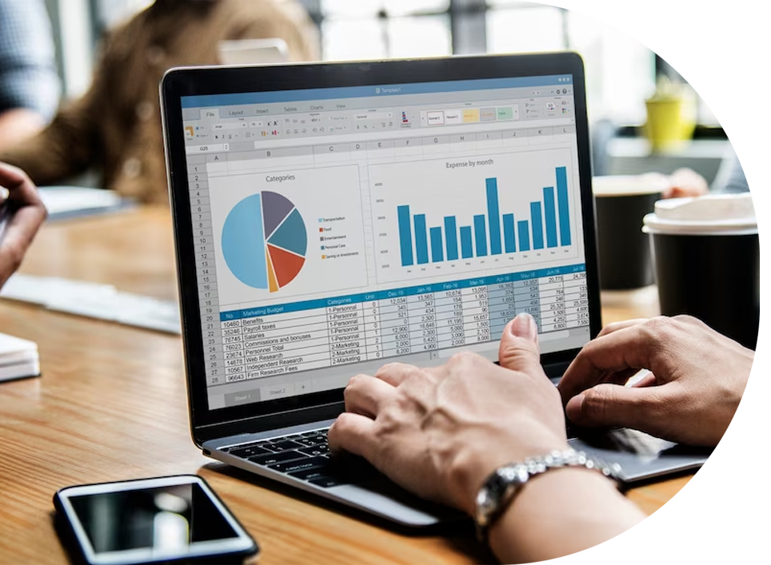
If you’re looking for results like these for your business, we recommend combining our monthly local SEO & organic SEO campaigns. This ONE-TWO PUNCH will maximize results and deliver stronger results for your business.
Not sure what you need to succeed? We offer custom campaign recommendations to manually evaluate your current position!

