Slide 1


BUSINESS OWNERS…
ARE YOU READY TO INCREASE YOUR
WEBSITE TRAFFIC BY 149%?

Slide 2


KNOW THE VALUE OF
DFY SEO SOLUTIONS
FOR ONLINE BRANDS
Rankings don’t happen overnight. If they do, they won’t stick for long.
It takes time and consistent effort to rank organically on page 1. That’s why we combine real, in-depth thought with crucial competitor data and tested ranking tactics in order to help each of our DFY SEO campaigns excel. There’s a lot that needs to go into every campaign in order to make it successful; but when all of the pieces line up just right, you’re in for some spectacular SERP gains and traffic increases! In this case study, we’re going to explore one of the biggest goals of any SEO campaign: TRAFFIC.
And we’ll show you exactly how we’re getting it for our clients month after month after month.

Slide 3

With the right SEO campaign, you can achieve more than ranking for low hanging terms. We create a long-term strategy to propel your rankings, along with INCREASES IN TRAFFIC AND LEAD GENERATION! But what does a truly valuable SEO campaign look like?
Our Monthly Organic SEO campaign was able to skyrocket organic and local traffic for a service area business in a major US city. The results demonstrate why our packages are such a POWERFUL METHOD FOR IMPROVING RANKINGS and generating more traffic for brands large and small.
Over the 1st six months, our team more than DOUBLED THE AMOUNT OF TRAFFIC from new users, bring in additional leads and sales. Six months might seem like a long time, but it’s only a breath in the world of SEO. While a single, well-placed link with the right anchor text could skyrocket your website rankings overnight, a single misstep can set you back months of hard work.

Slide 4

Whether we’re looking at a small or nationwide website, the first step in every campaign is run a thorough TECHNICAL & QUALITY AUDIT.
It’s CRITICAL TO THE QUALITY & RESULTS of our painstakingly-crafted strategy. Not only do we need to know where you’re starting out and what’s holding you back. We also need to know what competitors are doing right so we can hit those marks as well. For example, heavier anchor text optimization could easily lead to early improvements for our own client site, but we won’t know until analysis is completed

Slide 5


ENSURE PROPER ANCHOR TEXT
One thing we know for sure is when any new client comes onboard we need to immediately start working towards a balanced anchor text profile. Many sites come to us with virtually zero anchor text profile, while others have an over-optimized anchors. Both are bad.
Your anchor text matters. Whether we’re building a guest post or syndicating a press release, the type of anchor used and the properties linked can significantly impact the overall health of your campaign. Not to mention the URL optimization, or even the name of your brand.
No matter where your site is starting, the ANCHOR TEXT ANALYSIS AND THREE MONTH LINK MAP included in every SEO campaign will help ensure your site always has a robust yet balanced anchor text profile.

Slide 6

THE AUDIT
We spent years honing in the elements that make up our IN-DEPTH TECHNICAL AUDIT used in every single SEO package. With an intense audit process like ours, it’s no surprise our campaigns dot all of our ‘I’s and cross our ‘T’s. Using a series of tools and checks, we look for major technical issues – like poorly written urls, missing titles and metas, and broken links, alongside more discrete quality factors – like keyword cannibalization, thin content, and poorly construed EAT.
Our audit finds every issue and weakness, then we get to work fixing them!

Slide 7
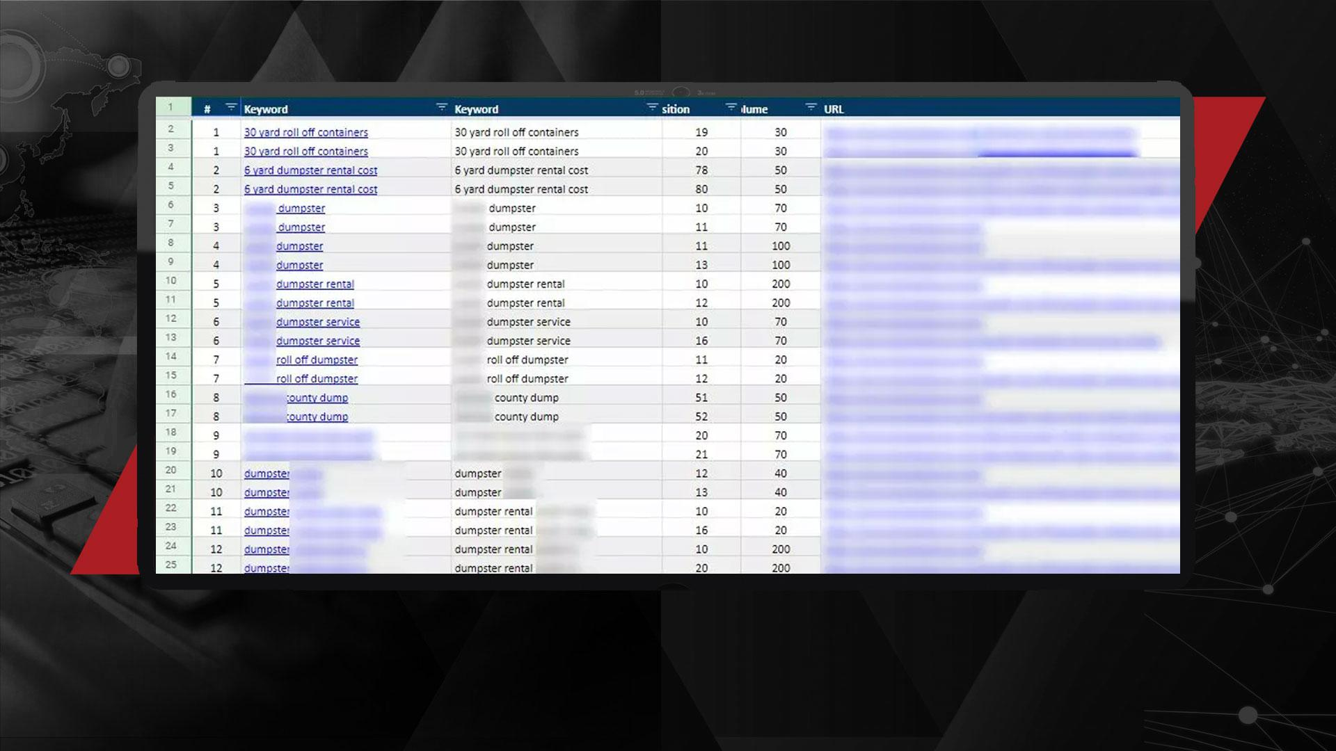
In this case, our client had many terms ranking across several pages, causing concern that cannibalization issues could be holding back the rankings. There was also a concern that the client’s website did not have a viable amount of backlinks when compared to competitor sites. Lower backlinks can be a huge concern for any website, especially when competing against sites sites with large link profiles.

Slide 8

THE LINK STRATEGY
Every website requires INDIVIDUALIZED ANALYSIS & STRATEGY in order to rank effectively. Some sites will have too many links pointed to a single page; others may have no backlinks at all. The existing optimization, the level of competitor optimization, and even industry can all factor into how we build our optimization and link building strategy. But what is involved in the SEO strategy?

Slide 9

Our SEO and link analysis begins by looking at the site’s current backlinks profile – starting with anchor text ratios and backlinks spread across the site. Then, we compare that to the backlink profile of the top 3 competitors for your seed keyword. By comparing ratios and checking the link spread, we can better determine whether:
1. We should target more pages or more nested subpages of the site
2. We should use more keyword rich anchor text, like exact or near match terms, or reduce keywords in anchor text.
Each strategy is a compilation of anchor text styles, including longtail and brand + keyword, variations, exact match, partial, and general terms. This targeting strategy is included in all of our SEO campaigns throughout every month of the campaign. It can also be used for additional link building services in future.

Slide 10
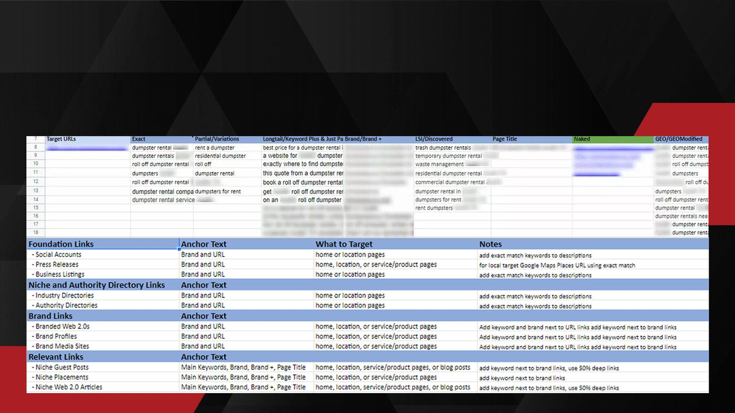
While we aren’t able to show the full keyword details in order to protect the anonymity of our client, you can still get an idea of the ROBUST LINK STRATEGY we use in our campaigns, and how it lays the foundation to create clear and concise link building strategies down the road.

Slide 11

THE SETUP
Once we’re aware of the obstacles to overcome in the campaign, and we know how well the site is or is not ranking, we can start getting down to business.
Our campaign managers leverage the link strategy crafted in the previous step to GUIDE CORE TASKS like building links, optimized press releases, authority niche placements, and the monthly optimized blog content.

Slide 12

COMPETITOR PARITY IS
CRITICAL TO SUCCESS
While implementing our link strategy, the on-page team digs into the website and begins optimization based on our competitor analysis and audits, as well as best practices. Then, your site is audited again, this time conducting a deeper review of your content and technical SEO. Both are critical components to ranking.
Once we complete the technical optimization, our team will move on to the target page, creating contextual corrections and improving things like keyword density and term relevance.
We benchmark our on-page content against the current top ranking SERPs, then use that data to tweak your main target url. This helps us leverage a WIDER VARIETY OF TERMS while wider variety of terms, while ensuring the frequency of keyword usage is in parity with the usage of top- ranking competitors. If your page doesn’t have enough info to answer a query in the way that a competitor page does, we will write up additional content to fill that gap.

Slide 13

BRAND FOUNDATIONS
Every strong performing SEO campaign needs a solid foundation; a launch pad on which you can build and grow your brand. Just like any first impression, your brand needs to be presented in the best-possible light. But how can you make a good impression if potential customers don’t know you exist?

Slide 14

Putting your business FRONT & CENTER is where our brand foundations really take the spotlight. Starting with a full audit of the website and brand profile, we dig deep into what you you could do better and what your competitors are doing right. Competitor analysis unveils the websites where your competitors are listed and found. Then, we compare against your foundation to find and build the profiles you’re lacking.
Whenever launching a new campaign, publishing social accounts and press releases are two of the first steps. These elements are crucial to getting your brand out there and boosting any valuable brand properties you already have.
But this isn’t all that makes up a strong foundation - everything from on page and technical corrections to content creation and off page link building should be present. Our SEO solutions touch on all prominent areas, creating a MORE POWERFUL CAMPAIGN for all-size companies.

Slide 15
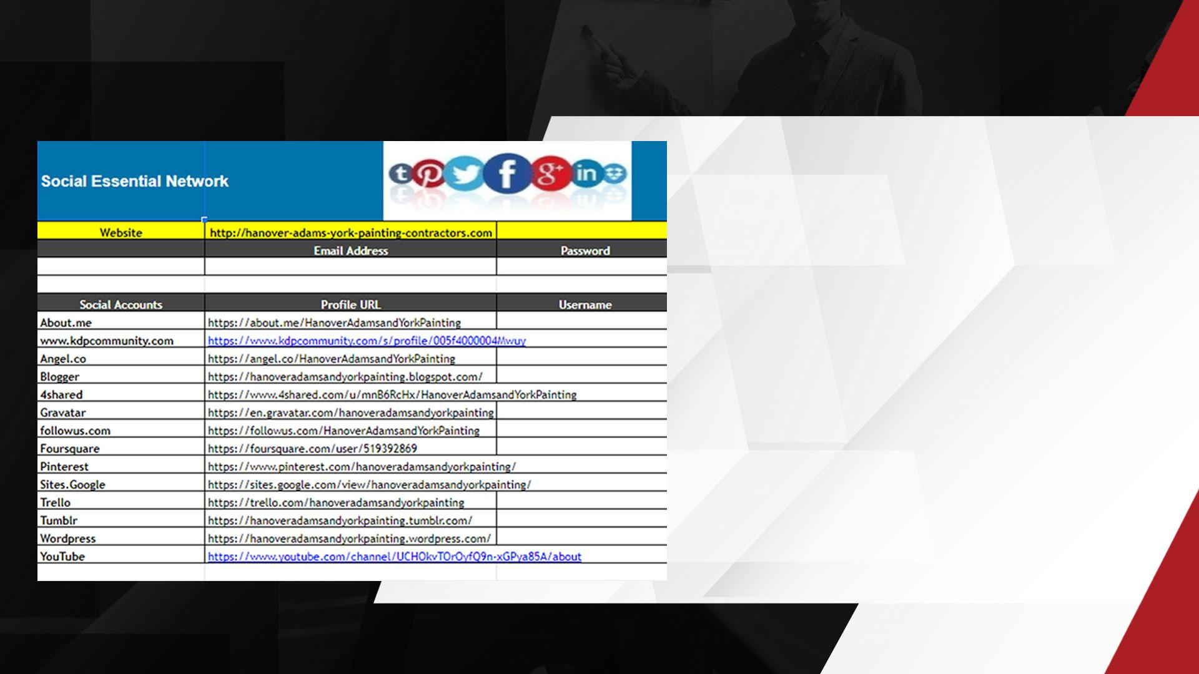
When creating properties like social accounts and press releases, it is important to use the right linking strategy. For example, directly linking to your website using keyword-rich anchors could net you a Google link penalty. No one wants that.
That’s why we create a SAFER BACKLINK STRATEGY that pushes link juice and authority back to your site by using only naked links or brand name anchor text to link back to your money site. Keyword anchors should be pointing to local properties like the GMB listing and existing citations, that way it ensures your website’s safe while also benefiting existing off-site properties.

Slide 16

ON PAGE & INTERNAL
LINK SILOS
At the core, our campaigns ensure your website – the foundation of your entire online presence – is PROPERLY PREPARED TO RANK. Addressing underlying on-page and tech issues, like bad url structure or cannibalization is crucial. But we don’t stop there…
Ensure your site is set up for success with a campaign that maximizes the impact of link building and content efforts. In many cases, a simple content refresh is all you need to start popping in the SERPs. However, many websites but don’t properly optimize
and link content into effective silos. Siloing pages (also known
as internal linking) not only shows Google the architecture of
your site, but also improves user experience. By linking
relevant content with intelligent keyword anchors, users
are led deeper in the site to discover and engage further!

Slide 17
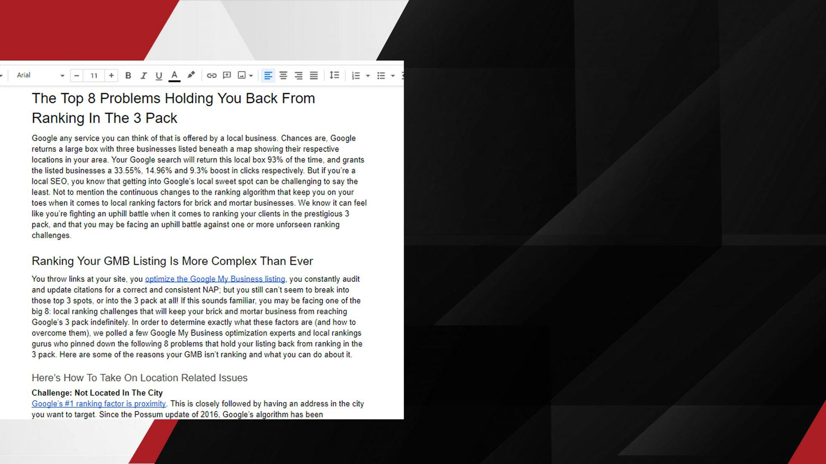
But competitor based on-page strategy is critical too…
Benchmarking your site against those already ranking highly for your target terms creates an EFFECTIVE SEO ROADMAP. Issues like keyword density, cannibalization, headers and meta, or a lack of content rich pages will cause you to fall short, so they’re quickly addressed in every campaign. Our optimization system helps us to easily pull data from top ranking competitor sites for our given terms, which we then use to optimize existing content and create new content as needed. Through a team of trained SEO copywriters, we’re able to create easily readable, optimized content that can be added to your site to improve your competitor parity for word count, topical relevance, and keyword density.
FRESH CONTENT not only helps your site remain relevant, it’s also an essential part of any proper link building campaign. By researching competitor blogs and key industry topics, we’re able to create regular content pieces that rank for longtail and informational terms. This enables us to spread link juice around for a more natural backlink profile.

Slide 18

TAILORED LINK TARGETING
Every SEO campaign includes tested backlink strategies that we customize based on your current link profile and the link velocity of competitors. Link building and on-page are two of the most crucial aspects of any optimization plan. However, too often agencies use pre-packaged, out-of-the-box solutions that are pretty much the same for any brand.
In order to maximize your ranking impact, you need strategies specific to YOU. It’s useless, even harmful, if your agency doesn’t know where your backlinks profile stands against your competitors. Imagine spending your budget to build 40 links using exact match anchor text, only to find out the agency over optimized your anchor text ratio or built too many links at once, thereby tanking any rankings you may have previously held.

Slide 19

P A R T 3 :
EVALUATING
THE RESULTS

Slide 20

Each SEO campaign’s performance is based on tangible, REAL-WORLD KPIS:
Keyword rankings
Organic and referral traffic
Keyword market share
There are other performance indicators we may touch on to ensure progress, but these three are the primary elements we will look at when evaluating your campaign. These are the biggest indicators of a brand’s online success.

Slide 21
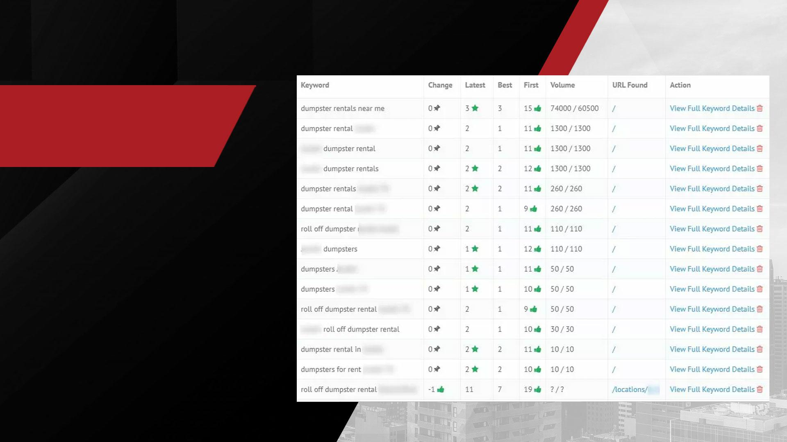
KEYWORD
RANKINGS
First, let’s look at this client’s organic rankings. We include a keyword tracker is in every campaign, making it easy to check rankings at a glance and understand exactly how your campaign is performing.
We sort the keywords by volume to highlight our toughest terms.. After 6 months, nearly all organic terms were within the top ten, with the exception of a few newer terms we had recently started to optimize for.

Slide 22
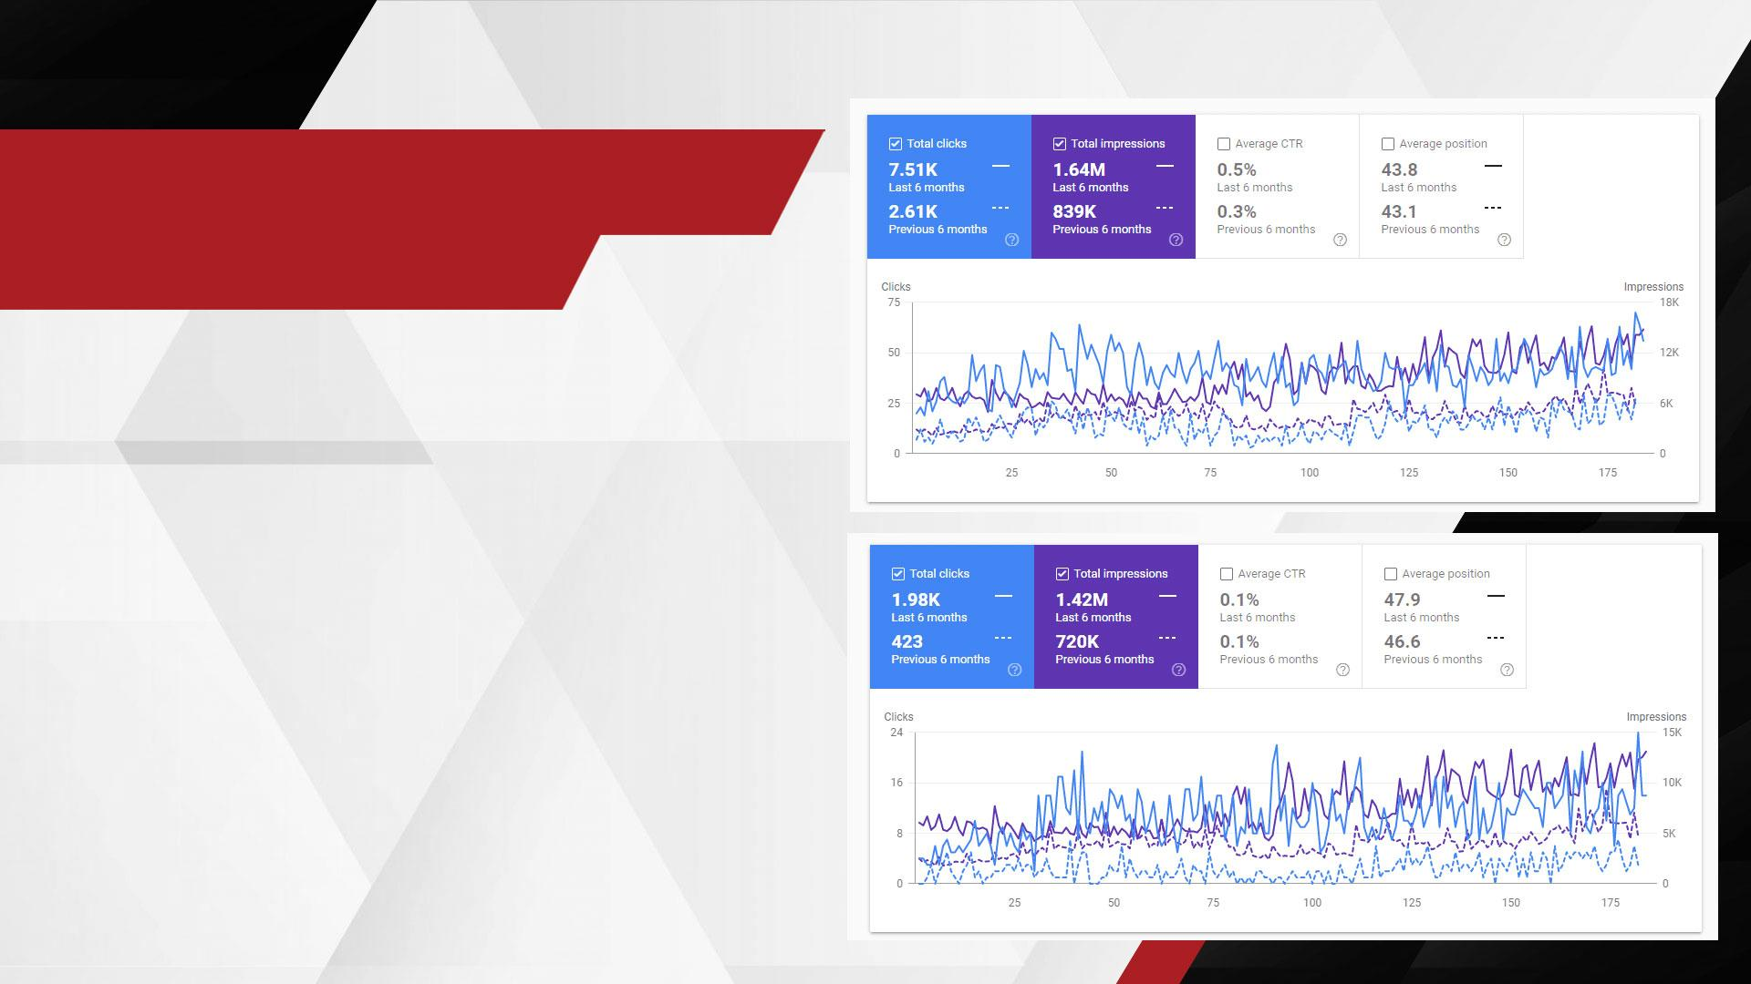
KEYWORD MARKET
SHARE VALUE
Your keyword market share represents the portion of keywords your site is ranking for, or your share in that niche’s keyword market. The higher your keyword market share, the more likely you are to bring in additional organic traffic and even improve your rankings! Why? Simple visibility.
To the right, you see the keyword market share for our client over the course of their 6 month Elite SEO campaign. Normally, we remove the brand name keywords, or any portion of the name, in order to remove branded terms. Your website will naturally rank for these terms. This allows us to see the specific keywords that are BRINGING IN NEW USERS.

Slide 23
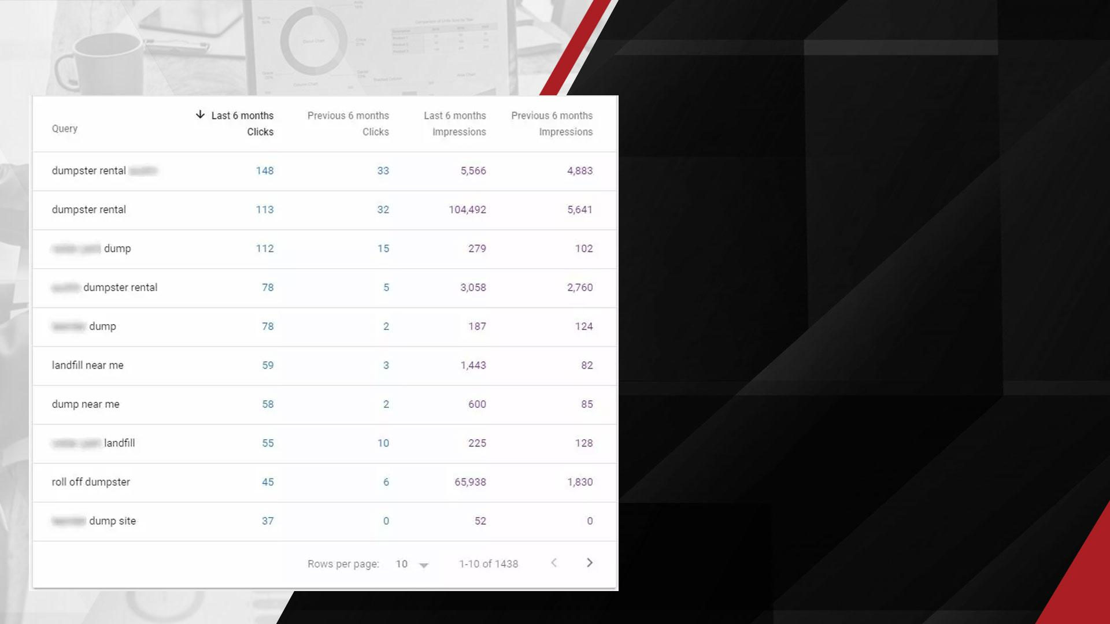
Generally, removing the brand terms will lower our overall market share number by a fair amount. But in this case, we can still see that our keyword market share for the six months of the campaign is still nearly DOUBLE what it was when we started. That’s a massive uptick in valuable keywords for our client’s brand, and a lot more online visibility in organic search!
Here we see a report of the Top Queries for the site in Google Search Console. Two of the terms that saw the most growth over the six month period were ‘dumpster rental’ and ‘roll off dumpster’, which are both high volume and lucrative terms for our brand. That’s a huge win!

Slide 24
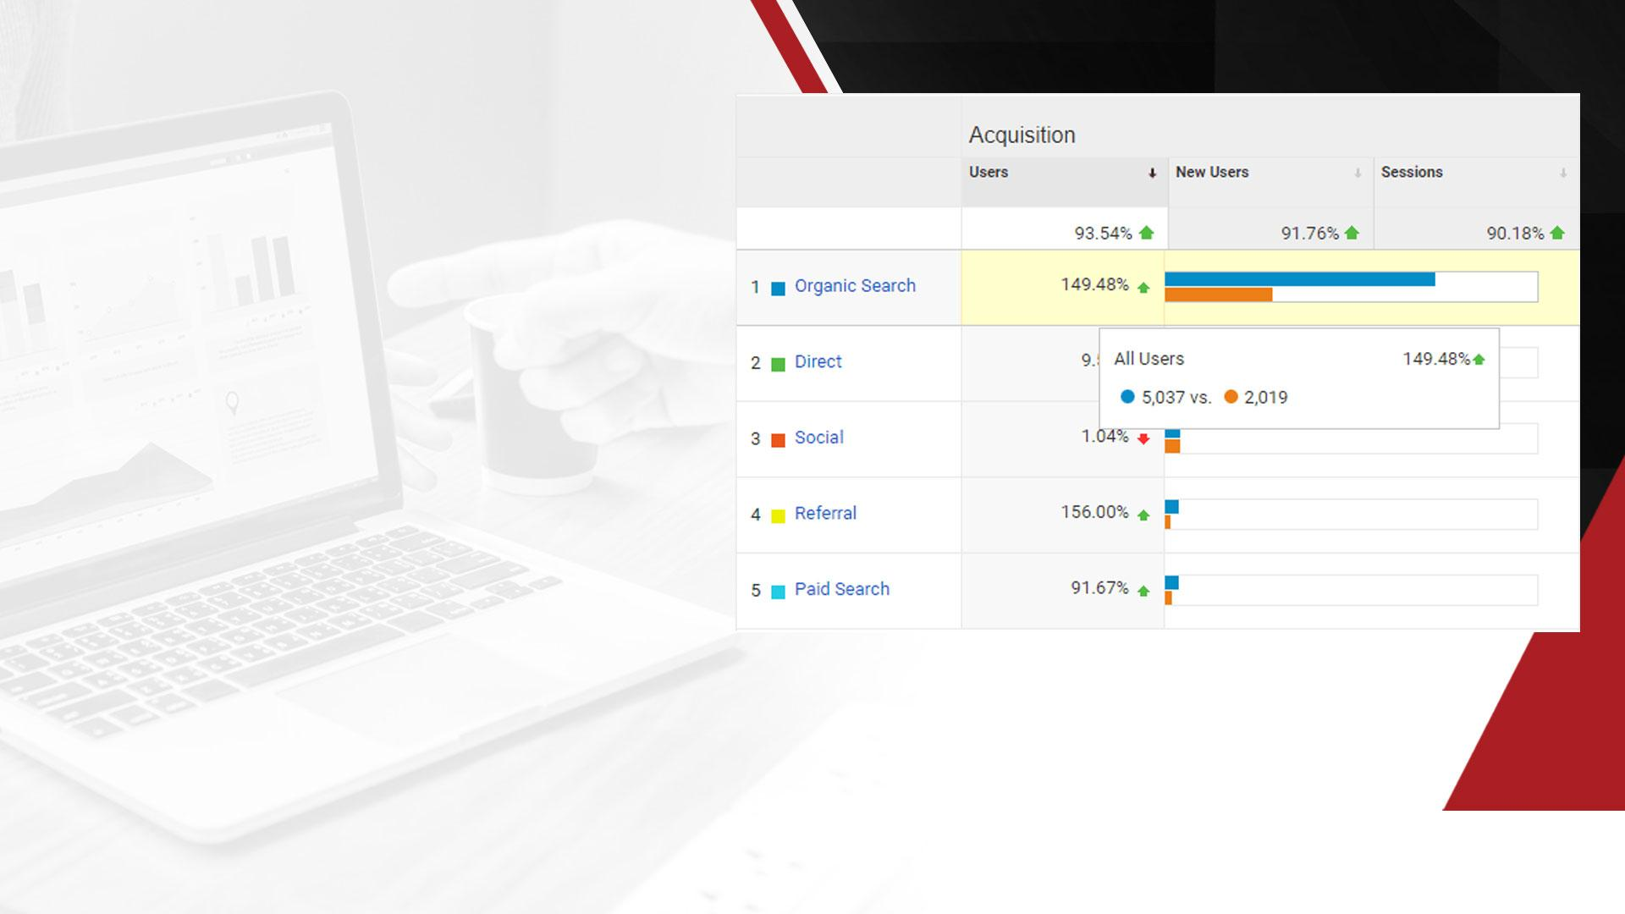
While we’ve been focusing on campaign design and keyword metrics, major bumps in traffic is at the heart of all the best organic SEO campaigns. Traffic for a website can come from a number of places, but one of the biggest will always be organic search.
It doesn’t matter how high you are ranking - if you aren’t getting traffic, you aren’t making sales. At the end of the day, calls and sales are the biggest impact of SEO services.
Our organic campaigns put a key focus on improving organic traffic and referral traffic month over month. It’s clear that the work our teams have been putting in for this client are paying off. WE MADE IT EASY for this client to see a stunning ROI with clear and concisely measured wins.
Organic traffic more than doubled, and our transparent reporting allowed them to understand how our goal of increased traffic became a reality.

Slide 25

WHY THESE METRICS MATTER
You don’t want to talk numbers; unless it’s about how much return you’re getting from your SEO investment.
It’s important that our SEO efforts are directly impacting the success of your business. All your high value keywords could be ranking on the 1st page of Google, but if your business isn’t getting calls, vague numbers and fancy pie charts won’t matter.
But understanding which metrics are going to be most valuable for a campaign is only part of the battle. You still need to find an agency you can depend on to incorporate STRONG SEO STRATEGIES. That where we come in!

Slide 26

P A R T 4 :
INVESTING IN
FUTURE SEO

Slide 27

We’re laser focused on ensuring our campaign options always take into consideration the latest factors for organic SEO. Whether that’s content, on page, technical optimization, or deep link building tactics, we include everything needed to generate MORE TRAFFIC, MORE LEADS, & MORE BUSINESS.
Start growing your online presence and building your
brand’s authority today with one of our Organic SEO
campaigns, designed to jumpstart your rankings!
No matter what your organic SEO needs are,
we’re here to help.
Let us analyze the best package for your brand with our FREE CAMPAIGN RECOMMENDATIONS!
Our custom recommendations provide clear and transparent analysis, ensuring you get everything you need to succeed. Plus, it’s easy! Just submit your business name and website link to get started.

Slide 28

It’s not always easy to find robust packages and solutions that are done-for-you and still include high quality work. That’s why we’ve spent YEARS perfecting our SEO strategy - so you can focus on running your business.
This enables us to stretch your budget and get maximum ROI out of every penny! Plus, we offer a variety of done-for-you SEO options, ranging from one-time setups and optimization to full service monthly optimization at varying levels of competition. There’s something for everyone!
No matter what your budget, we have a well- oiled SEO machine that can help you start ranking organically and building your brand visibility now.

