Slide 1

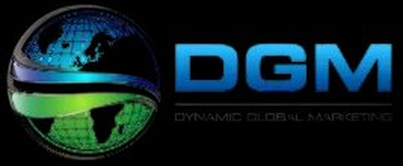
BUILDING AN
ECOM SITE WITH $263K VALUE
IN TRAFFIC
Using Our Done-for-You
SEO Campaign & Link Building Services

Slide 2


ORGANIC SEO SERVICES TOOK THIS CAMPAIGN’S
RESULTS TO THE NEXT LEVEL…
An 800% increase in indexed pages since the start of the campaign. That is huge.
Improvements of over 6,000 keywords
Plenty of those are #1 ranked buyer intent keywords
One of those terms by itself gets 5,500 searches per month
These numbers sound cool, but do you want to hear the best part?
These results have pushed almost 30,000 additional clicks over the past 90 days.
10,000 clicks per month on average.
What would your client sites do with an EXTRA 10,000 clicks per month?

Slide 3

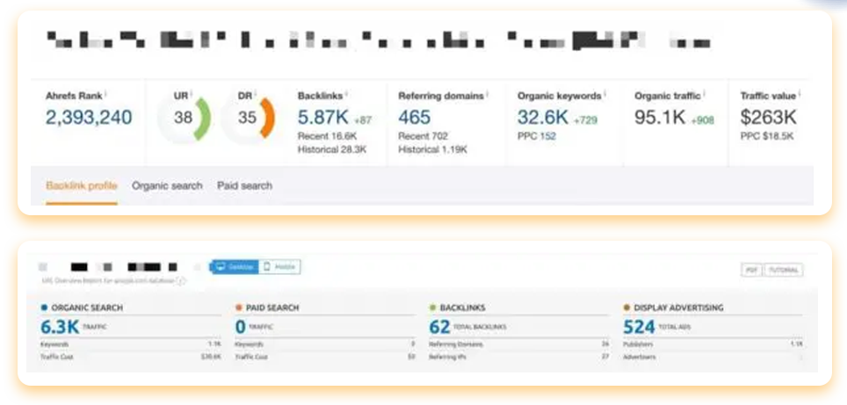
This is a national business, so they faced an
uphill battle of STRONG COMPETITION.
No holds barred, we’ll show you our exact process, and the RESULTS SPEAK FOR THEMSELVES…
The first image shows the currents stats from Ahrefs and the bottom image shows the site before we started our National SEO campaign.

Slide 4

PHASE 1: MONTHS 1-3
We created a scalable and effective strategy for SEO campaigns, both organically and to BOOST MAP RANKINGS - and they work. But, in order for them to work, due diligence checks must be completed early in the service.
We don’t want to convolute this case study with a comprehensive technical site analysis, but we start with a THOROUGH AUDIT using Screaming Frog. This allows us to crawl sites and export actionable spreadsheets to keep track progress of campaign work.

Slide 5

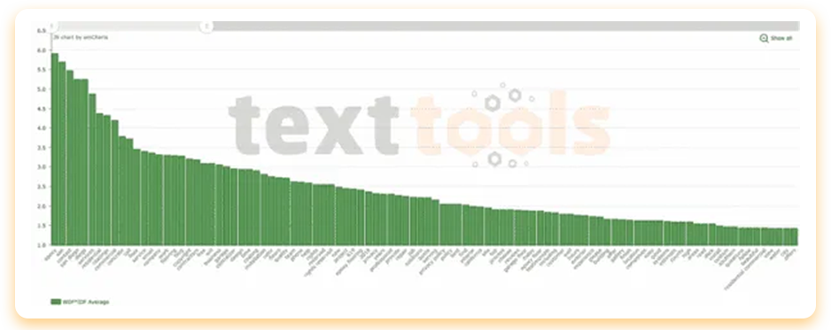
Next, we plan site level optimization. We combine a series of best practices with any anomalous findings we discover from the competitor analysis to ensure all bases are covered. Rarely do we find competitors are using site level practices that meet our standards, so this is usually the first opportunity to really OUTPERFORM OTHER SITES we are up against.
One of the most unique steps we take in every campaign is performing TF-IDF semantic research based on the SERPs you are competing in. Other agencies don’t do that!

Slide 6

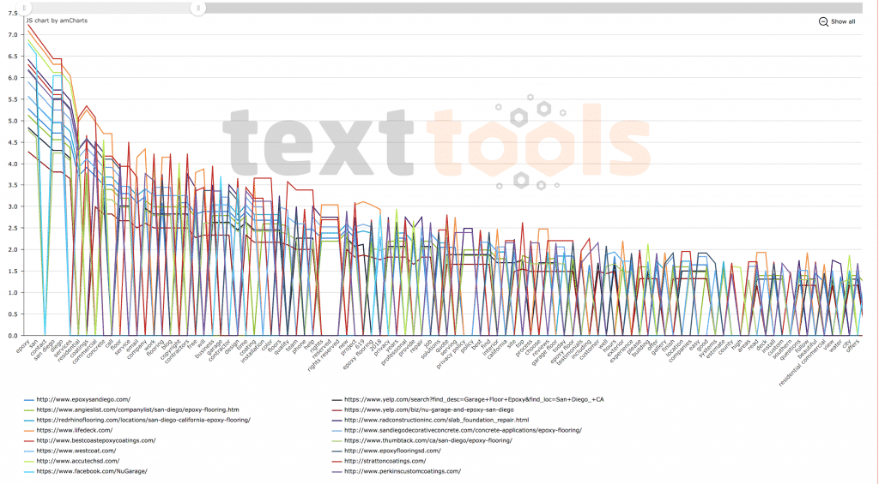
TF-IDF, short for frequency-inverse document retrieval, is a value used to determine the importance of text inside documents or sets of documents. Traditional on page optimization revolved around analysis and testing of keyword densities and the relation between keywords being used in too many places (keyword stuffing).
NOTE: THESE ARE EXAMPLES OF A DIFFERENT CAMPAIGN. THIS IS NOT THE NICHE OF THE SITE BEING DISCUSSED IN THIS CASE STUDY
Individual keyword and phrase utilization is still important, but we take this a step further to see what other words are typically used in conjunction with money terms and what those use rates are. This strategy TAKES ON-PAGE TO THE NEXT LEVEL using semantic optimization.

Slide 7

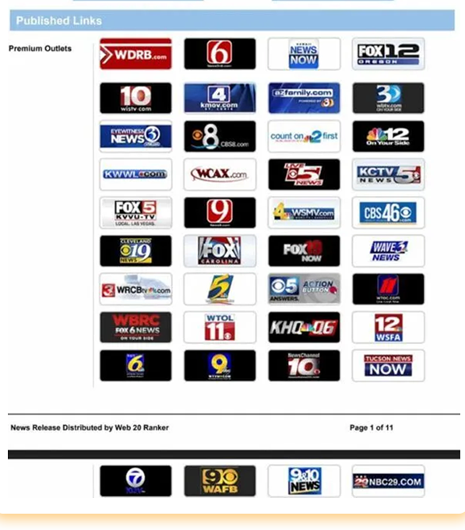
Once we have the site level optimization underway and our 23-point on-page optimization strategy going, we get busy with FOUNDATIONAL OFF PAGE ACTION items that prepare the site for the links we are going to build in the coming months…
This includes writing and syndicating a press release with highly targeted keywords, links, and anchor text.
There are a lot of SEO axioms that either support or argue against the impact of press releases for a campaign, but we have been consistently testing press releases for years. Plus, we also have empirical evidence derived from many use cases and we find them to still be extremely useful.

Slide 8

Another crucial component is the SOCIAL SIGNALS dripped into the campaign month after month.
We are firm believers that social links are a natural part of a real website’s backlink profile, so you need them to build a strong foundation for long term rankings.
Referral traffic from social sites look great too, especially as you are building other links and adding content to the site. It only seems natural that you would be getting some type of social interaction with the brand you are working on…
We believe, like with anything, the key here is not buying 500,000 signals at once, especially when dealing with local sites. It looks bad.
A NATURAL NUMBER AND LINK PROFILE is what we are after. While it’s not something that will provide dramatic results, it will create a more natural campaign.

Slide 9

Some people save their HIGH POWER LINK BUILDING for later in their campaign when the foundational links are built and indexed. However, we start incorporating hard-hitting links in the first few weeks to jumpstart the campaign performance.
Over the years we’ve established a lot of data showing that waiting to drip those more powerful links just stalls a campaign in the long run. The opposite of our goal.
As long as we are building them in an ongoing manner to help pad the backlink profile, we have seen no negative impact. This is typical for our link building campaigns.
We obviously can’t show you the exact links we built for this client, but all link URLs can be provided for your campaign.

Slide 10

There are a series of links and platforms we have at our disposal to use in our client campaigns. For this client, in their first few months, we used our
AUTHORITY NICHE PLACEMENTS.
We categorically break these links down by referring domains. It looks something like this:
Site with 25+ referring domains
Site with 50-200 referring domains
Site with 50-200 referring domains
Site with 200+ referring domains
Site with 200+ referring domains
Notice the main public facing metric our agency uses is referring domains. Third party metrics are unreliable at best, so we don’t rely on these metrics as fact. (and neither should you)

Slide 11
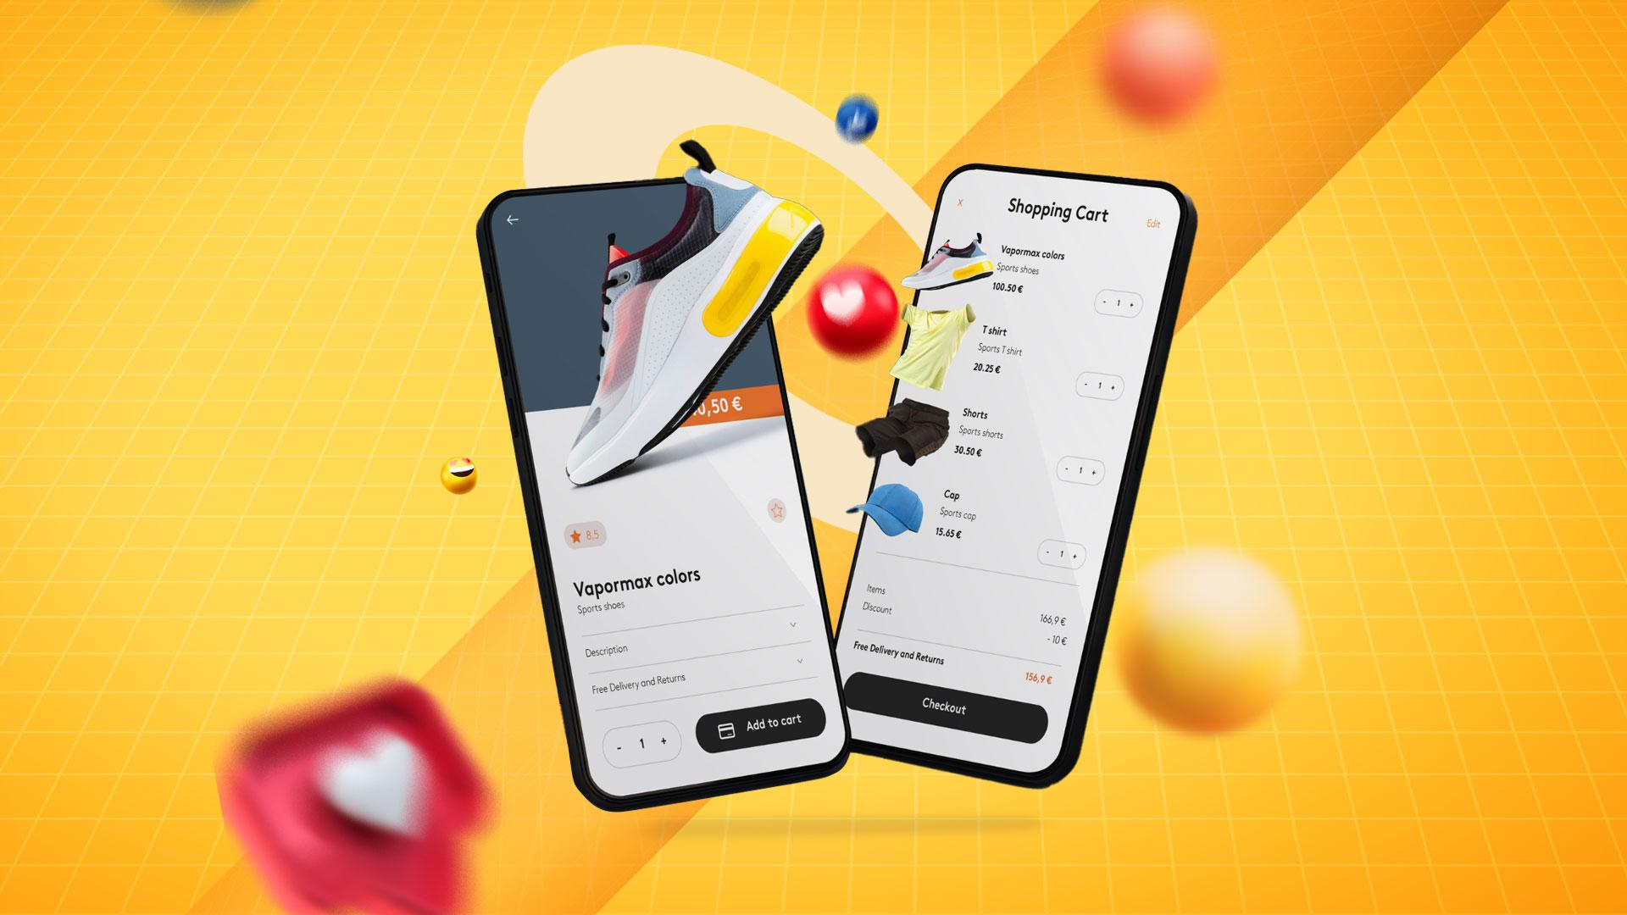
Further into the campaign (months 2-3) we circle back to perform quality checks on the site level and on page optimization.
We also ensure proper TF-IDF action plan implementation and target page optimization aligns with audits and analyses.
This includes internal linking, optimized header tags, meta descriptions, picture alt tags, and
page markup.
At this time, we also built another round of social and web 2 accounts for the brand.
These are secondary
accounts that further earn us solid brand links and help reinforce the online presence.
We aren’t just ranking a website, we create and BUILD A STRONG DIGITAL BRAND early on.

Slide 12

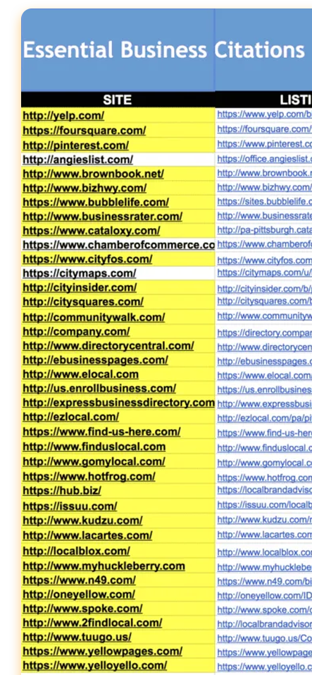
Reinforcing our brand-building efforts, we build out and optimize the TOP NATIONAL BUSINESS LISTINGS for the brand. Again, our early focus is to establish a lot of trust for the brand. We’ve found doing so helps propel rankings in the later months.
In this case we had our team create the top 42
business citations using unique content and descriptions on each, ensuring we give the search bots EVERY REASON TO CRAWL AND INDEX OUR BRAND PROPERTIES.
These essential citations are on general platforms such as Chamber of Commerce, Yelp, and YP, giving us even more brand mentions and links on authority platforms.
NOTE: THIS IS AN EXAMPLE REPORT(RIGHT), NOT THE ACTUAL COMPANY REPORT

Slide 13

We drip more social signals from platforms like
Facebook, Twitter, Stumble Upon and others, but at a slow rate of only 50 – 70
signals per month so this looks completely natural.
The heart of any SEO
campaign is QUALITY LINK BUILDING. We continue in month two to use a combination of niche
placements and guest posts using the anchor text strategy we defined early in the campaign.
We close out every month of the campaign ensuring proper crawl and indexation of the links. A brief caveat on Search index vs crawl. Crawl is imperative for Google to properly weigh and reward links. If Google does not crawl the link there can be no reward for that link. Crawl and index are two separate things though. Just because a link is crawled does not mean it will be indexed. Index does not have any effect on link equity or passing PageRank.

Slide 14

PHASE 2: MONTHS 4-6
The team is continuously building
additional pillow links and guest posts. This ensures we are not going to over optimize the anchor profile of the site, but still RANK FOR ADDITIONAL PRODUCT TERMS that have historically gotten the site owner a ton of traffic. It is important to monitor your anchor text numbers so you don’t set yourself up for a penguin filter.
As per usual we are building a mix of image, audio, video, web2.0 links, etc. Nothing fancy, just working toward a natural looking diversification at the end of the link building campaign.

Slide 15

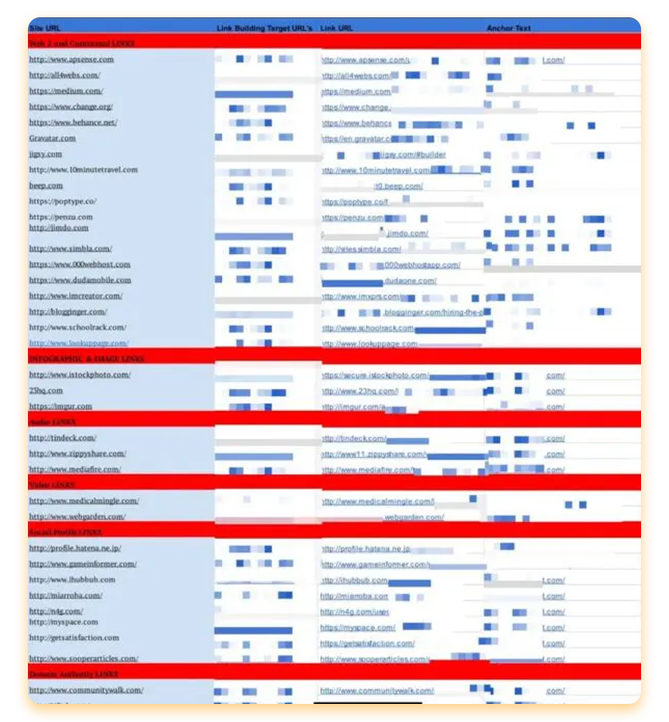
The main goal in these next few months is to round out the heavy hitter link building so we can continue to push the main keywords further up the SERPs and really START BRINGING HOME SOME ROI for our client’s campaign.
Because they wanted to rank nationally for these terms, the client had to get a bit more aggressive with their link building…
We included additional outreach links and authority niche placements as part of their service. The final anchor text looks like this for those that like to check out those type of things.

Slide 16

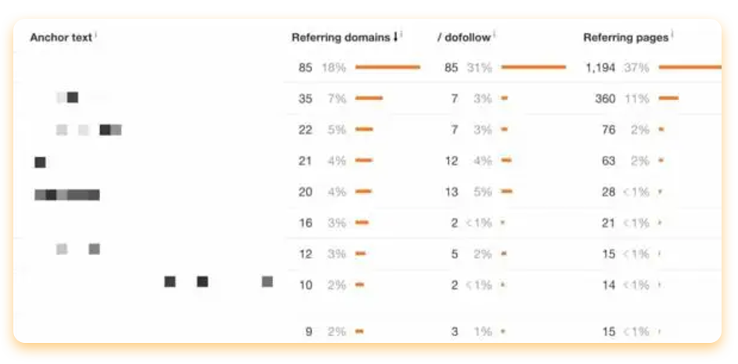
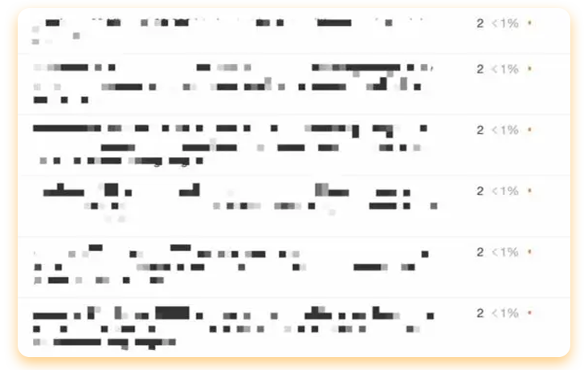
We blurred out the brand name and the URL, but from the screenshot, you can see that 48% of the backlink profile consists of Brand name and URL variations. This is pretty typical for our campaigns, as we like to remain somewhat conservative to avoid penguin related filters.
Before we get to the money keywords, we want you to take note of how we continued to diversify the backlink profile of the site, as well as create relevant anchors using long tail
strategies.
In this case, we could get super specific about makes and models because the company sells different products.

Slide 17

A diverse backlink profile is critical. It allows our backlinks to look extremely natural and opens the opportunity to rank for super specific searches by people looking for solutions our client provides.
We have never been a big fan of adhering to or suggesting percentages of money
keywords as anchors though.
Our best advice is to create a loose structure based on your competitors that are ranking in the top three and then measure and optimize as the campaign matures. It’s a moving target rather than a hard line.

Slide 18

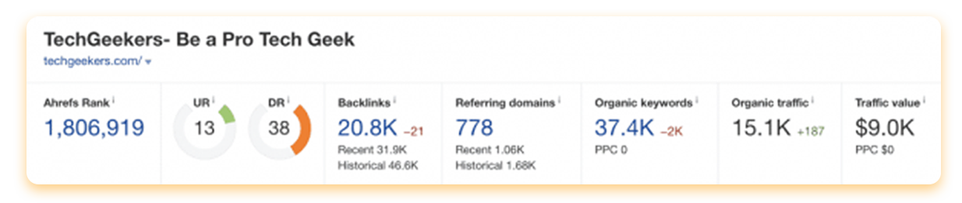
Extra guest posting provided an added boost for national rankings. However, you must be careful with guest posts. Oftentimes agencies have a list of sites they reuse over and over, without any real checks for quality assured posting. Many of those sites are also content mills with no real traffic or rankings. Their only purpose is to charge people for guest posting services by using inflated third party metrics to make the sale.
That’s not how we roll.
We outreach to sites with MINIMUM 10K TRAFFIC per month. While tools can be incredibly inaccurate with their traffic metrics, we use Ahrefs to benchmark this number and at least build a uniformed way of qualifying the guest posting sites in our agency’s repertoire.

Slide 19
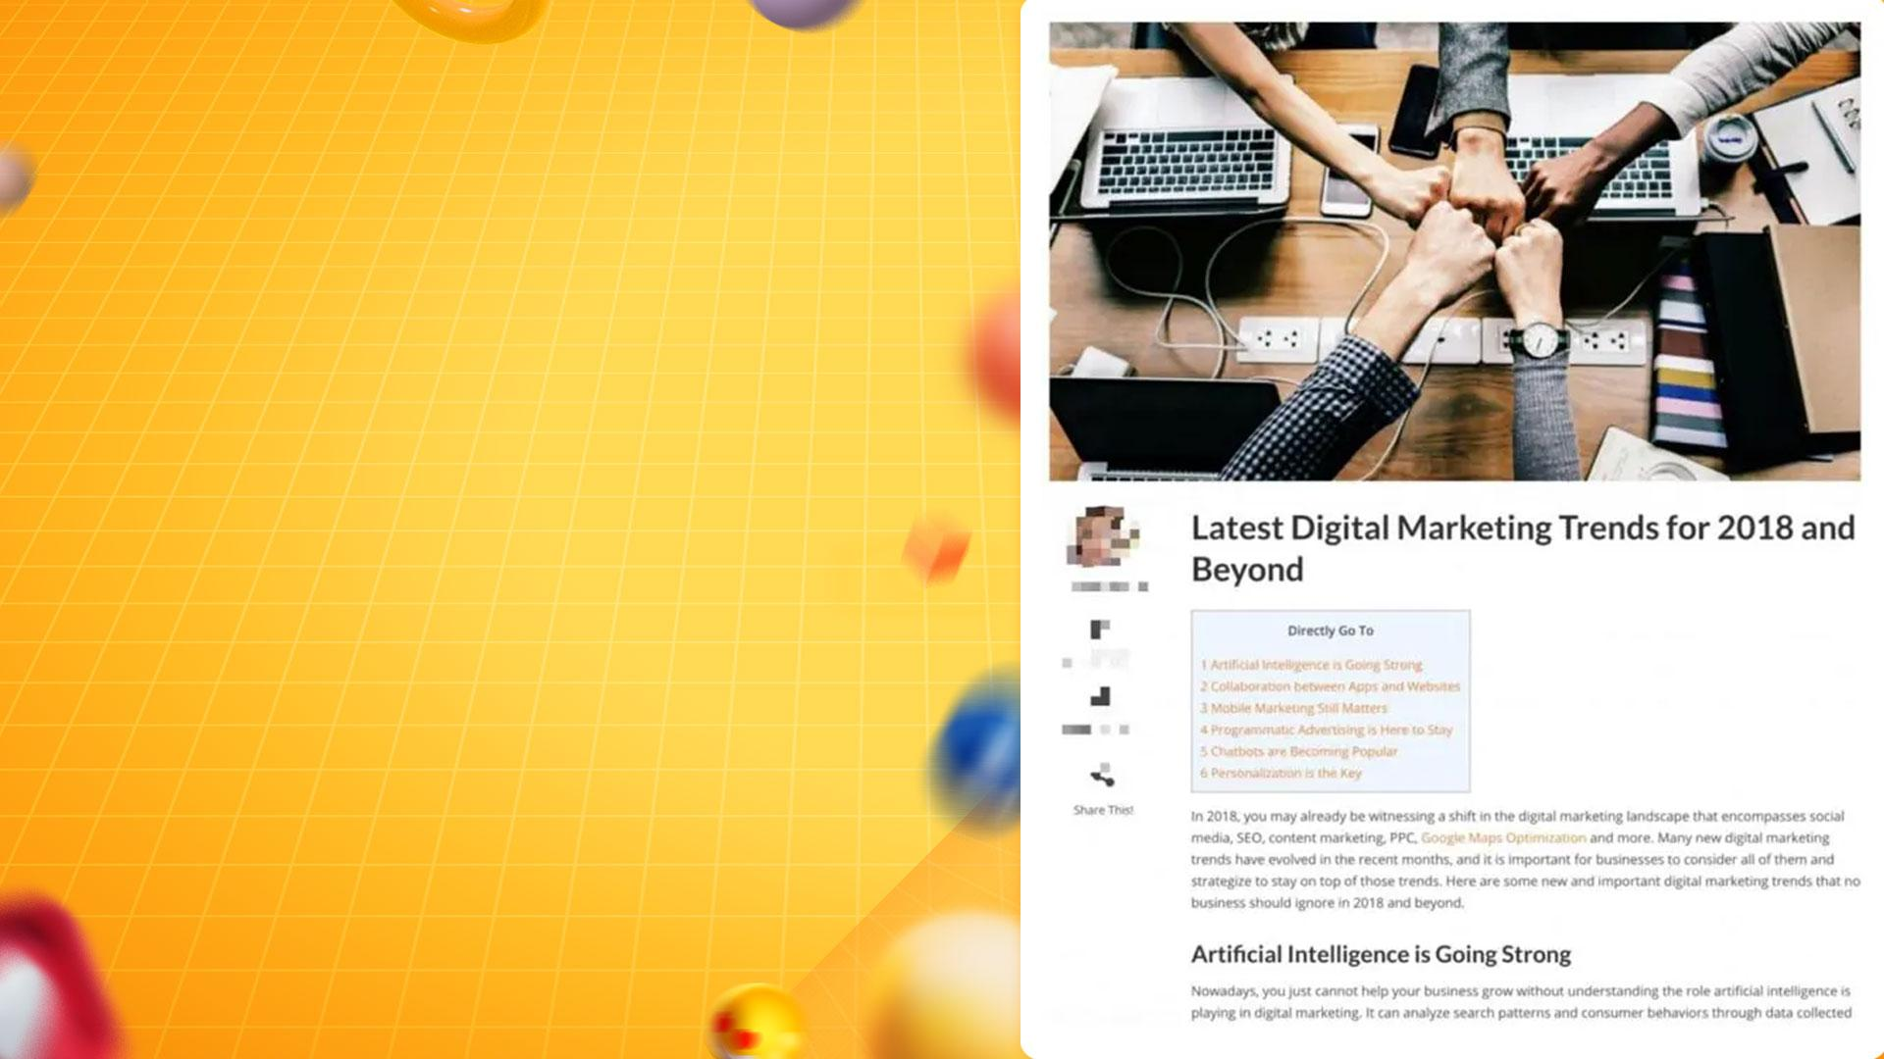
Sites with large traffic metrics are most likely real sites, so we then move on to the metric we find most important - referring domains. Links are still one of MOST IMPACTFUL FACTORS to Google’s algorithm. They pass link juice and help Google “grade” other pages.
That is why we couldn’t care less about third party metrics like Moz domain authority, Majestic Trust Flow. Those metrics are not indicative of ranking effect from links that are built.
The number, power, and relevance of the referring domains, however, are going to give us a SOLID IDEA about the positive movement potential.

Slide 20

Once the on-page is squared away, we continue to add blog content to provide additional link targets and interlinking. We also continue to pad your anchor text profile with pillowing links to maintain safe anchor percentages as you add new power links every month. This consistent SEO propels your campaign forward and helps you maintain your rankings.
WANT RESULTS LIKE THESE?
Our agency can provide exactly that. Just contact us to get more information on what campaign is best for your needs!

